Slide 1
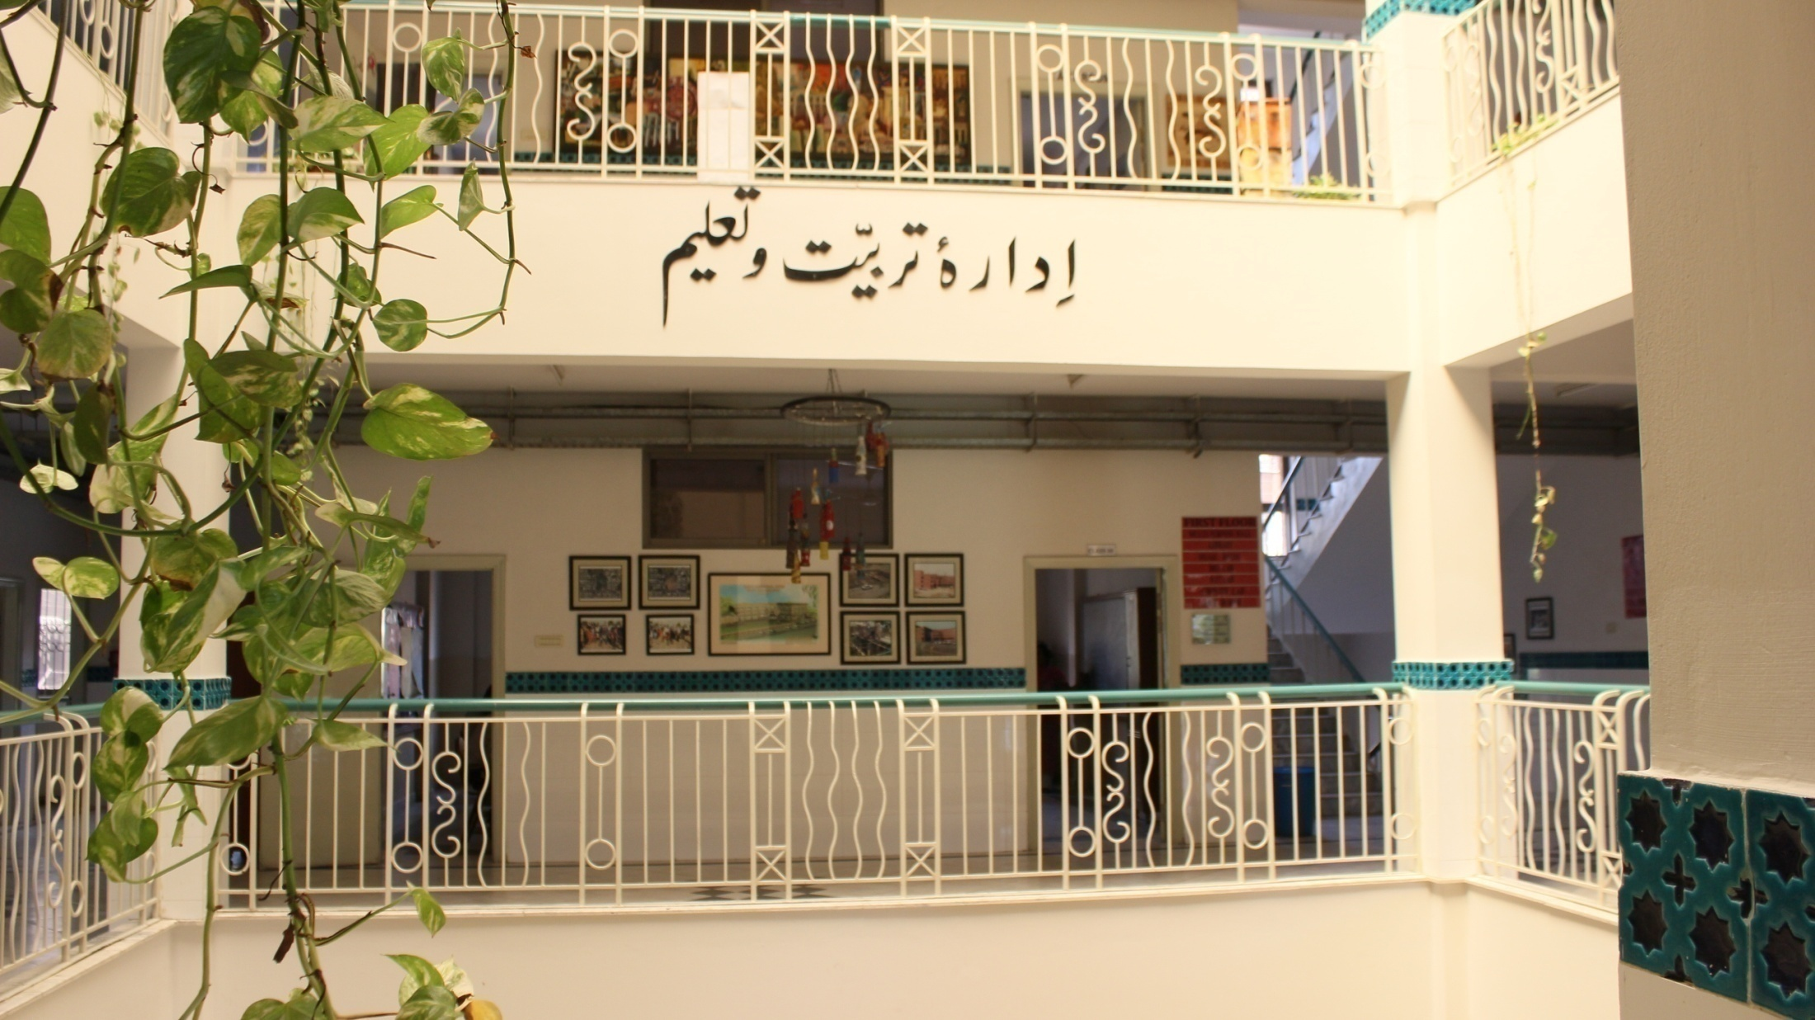

Slide 2
IS ALL ABOUT JOINING HANDS

Slide 3
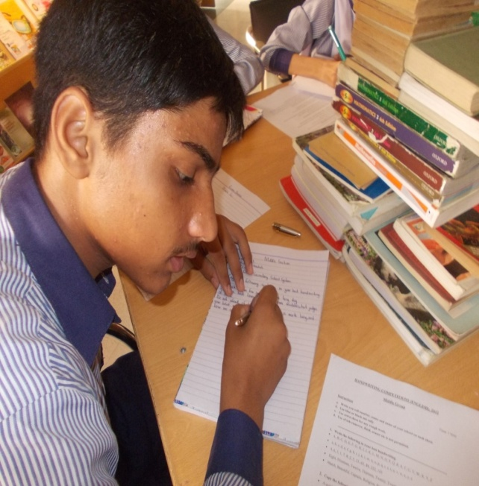
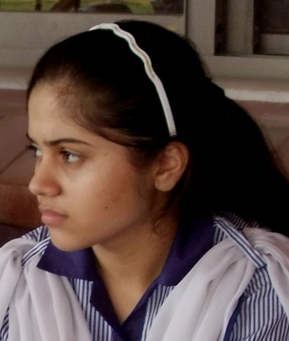
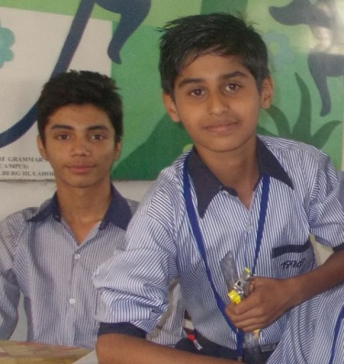
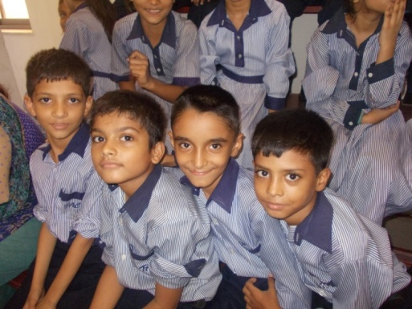
THE HELPCARE SOCIETY
VISION
REALISING POTENTIAL THROUGH EQUAL
OPPORTUNITIES

Slide 4
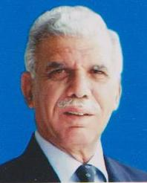
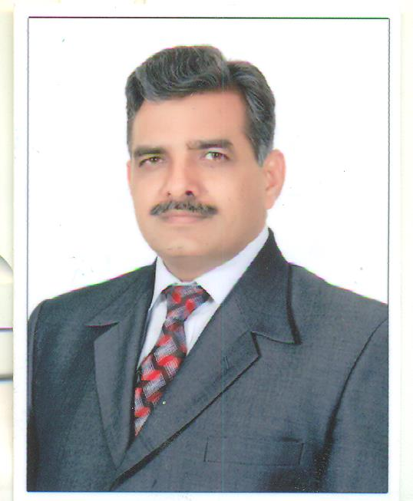
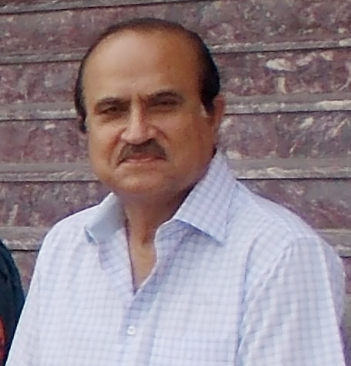
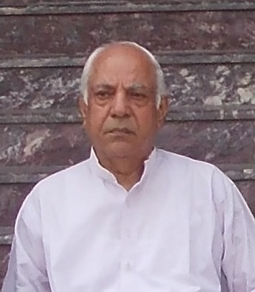
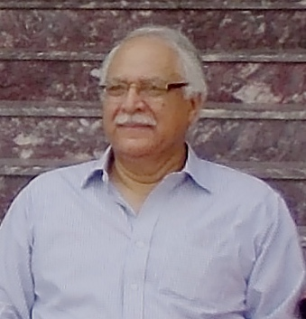
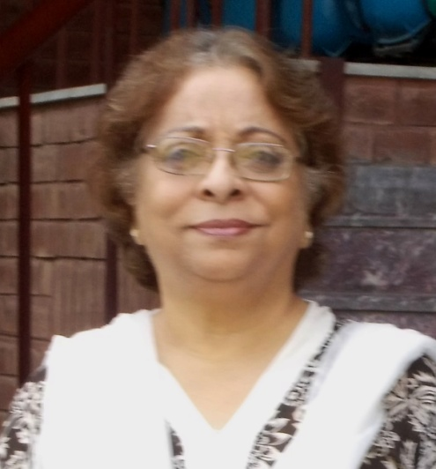
BOARD OF GOVERNORS
Lt. Gen. (Retd.) Muhamamd Maqbool*
Chairman - The Helpcare society (THS)
Brig. Zafar Yasin Babar
Administrator, Defence Housing Authority
Mr. Mubashar A. Siddiqui
Secretary General THS
CEO, Raiinmakers PVT. Ltd.
Mr. Abdul Wahid Khan Retired Businessman
Executive Member
Pir Farid Ahsanuddin
Chief Executive, Republic Engineering Ltd.
Executive Member
Mrs. Farida Maqbool
Executive Member

Slide 5
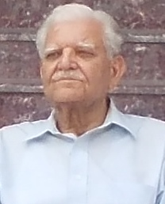
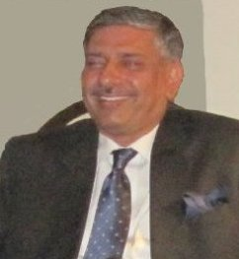
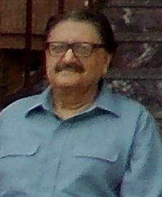
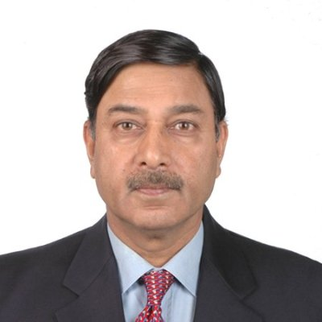
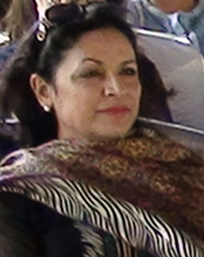
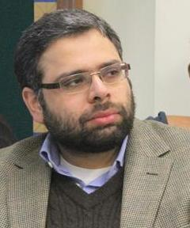
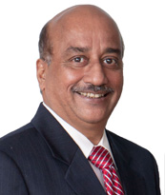
M.Yahya Mir
Retd. Engineer
Dr. Tahir Mahmood Hayat, Phd,
Vice President, NESPAK
Mr. Masood Ali Khan
CEO, Takhleeq Designing
Maj Gen Tariq Hameed (R)
CEO, LPG Marketing Co.
Osman Maqbool
Prprieter , MacCorp Servises / Franchising Consultant
SubWay International
Miss Ayla MajidDirector,
Business Advisory Services
KMR Charted Accountants
Mr. Shabbir Hashmi
Director, Engro Corporation Limited
Mrs. Qaiser Shamim
Business / Philanthropy

Slide 6
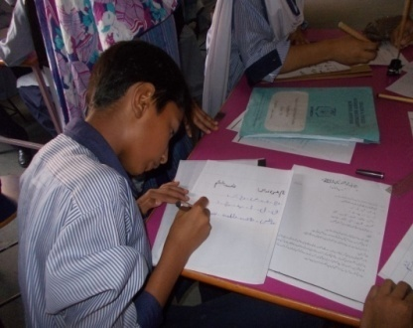
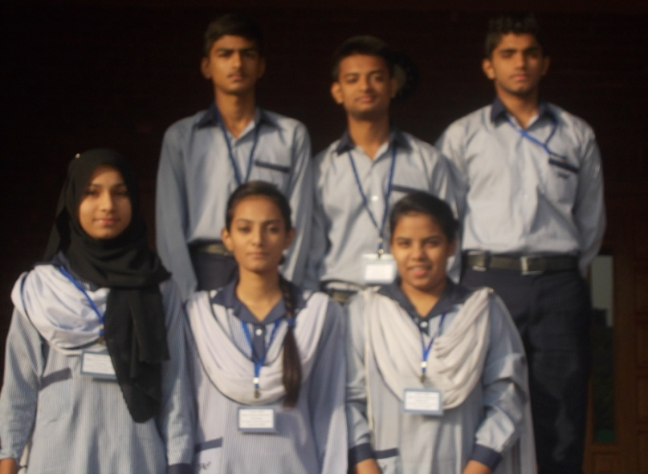
TEACH A CHILD (TAC) SCHOOL SYSTEM AN EDUCATIONAL PROJECT OF “THE HELPCARE SOCIETY”
AIM
To create a centre of socio-academic
Excellence (Idara e Tarbeeat o Taleem)
for the underprivileged.
MISSION
With competitive education, enable
and empower the underprivileged
children to join the socio- professional
mainstream.

Slide 7
TEACH A CHILD SCHOOL SYSTEM
OBJECTIVES
To provide competitive academic and professional excellence to
enable “TAC Children” to enter the future market place with
dignity.
To impart high moral values and ethics.
To inculcate a sense of duty towards the family, society and the country.
To provide appropriate socio-cultural skills, for them to merge into the national mainstream and multi-national environment.
To develop self esteem, confidence and belief in themselves.
END OBJECTIVE
To enable them to emerge as role models and positive agents of
change in the family, neighborhood and the society at large.

Slide 8
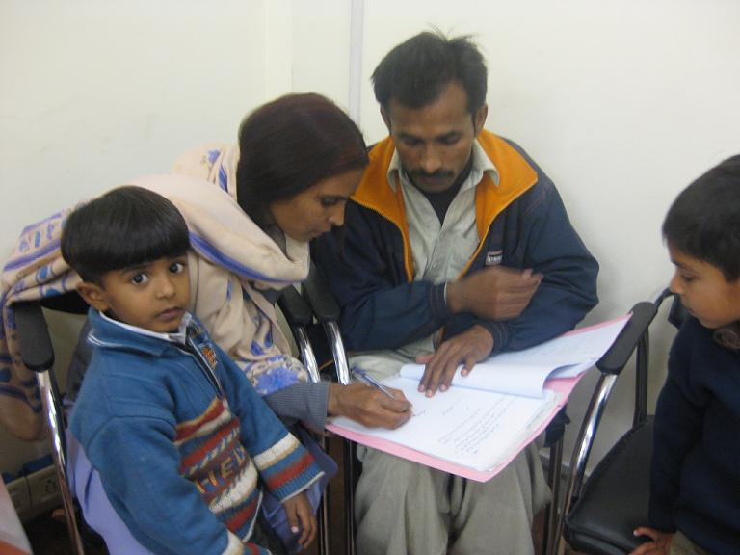
SELECTION PROCESS
Johar Town Campus.
50 students per year
DHA Campus.
50 students TILL THE DEVELOPMENT
OF THE NEW CAMPUS / EXTENSION BLOCK.
On availability, gradually increase it to 100 per year.
Age between 3.7 and 4.6 years.
One child from one family.
SATIP ( Siblings at TAC Incentive Programme).
WIP (Wards’ of Teachers Incentive Programme)

Slide 9
SELECTION CRITERIA
Economic merit based on “clean, well defined and verifiable source of
income.
Ground verification is an essential part to confirm the economic
status and domestic environment. “Poorer the better” is fundamental
to economic merit.
Parental merit to determine their ability to support the dictates of
quality education. System fully recognizes the financial and
educational limitations of the parents, it basically demands their commitment and ability to provide conducive environment at home.
Competitive intellectual merit through professional IQ testing.
“Economic” and “intellectual” merits are merged to draw out a “combined merit
Board of Governors and Ground Verifiers constitute the final selection board.
Board’s approval is followed by an entry test. The score is simply added to arrive at the merit list.
SELECTED STUDENTS EMBARK UPON
18 YEARS LONG ACADEMIC PURSUIT.

Slide 10
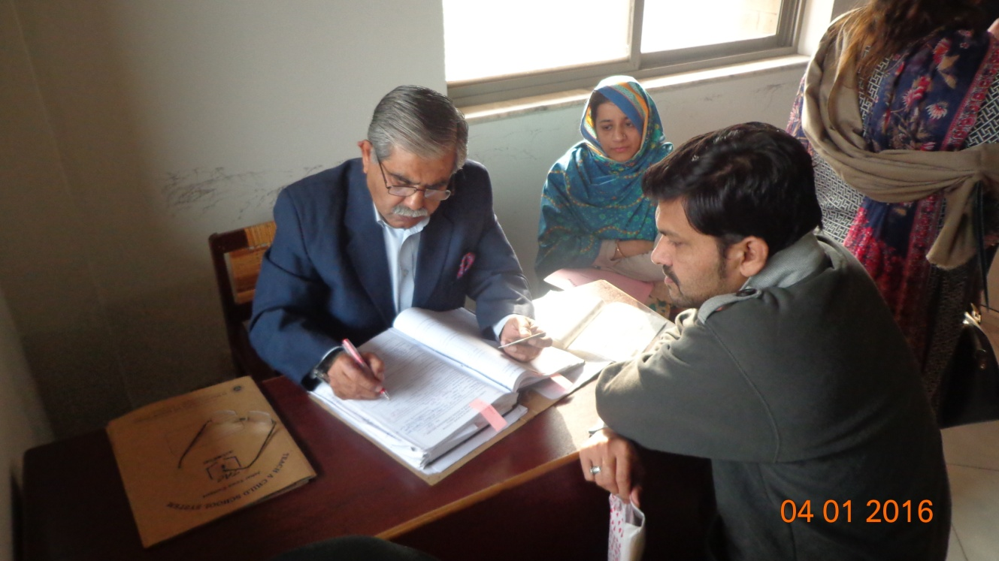
Mr. Ajmal, Volunteer
INITIAL INTERVIEWS
FIRST CONTACT WITH
APPLICANT FAMILY
Mrs. Brig Rehan,
Volunteer

Slide 11
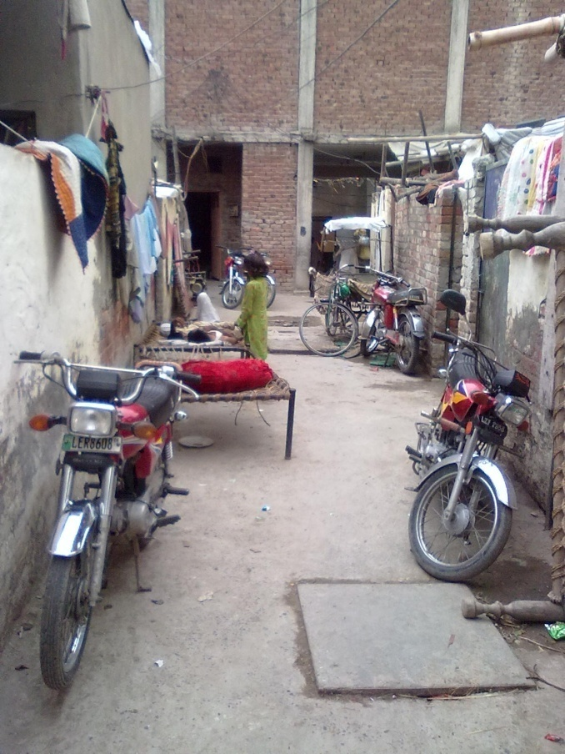
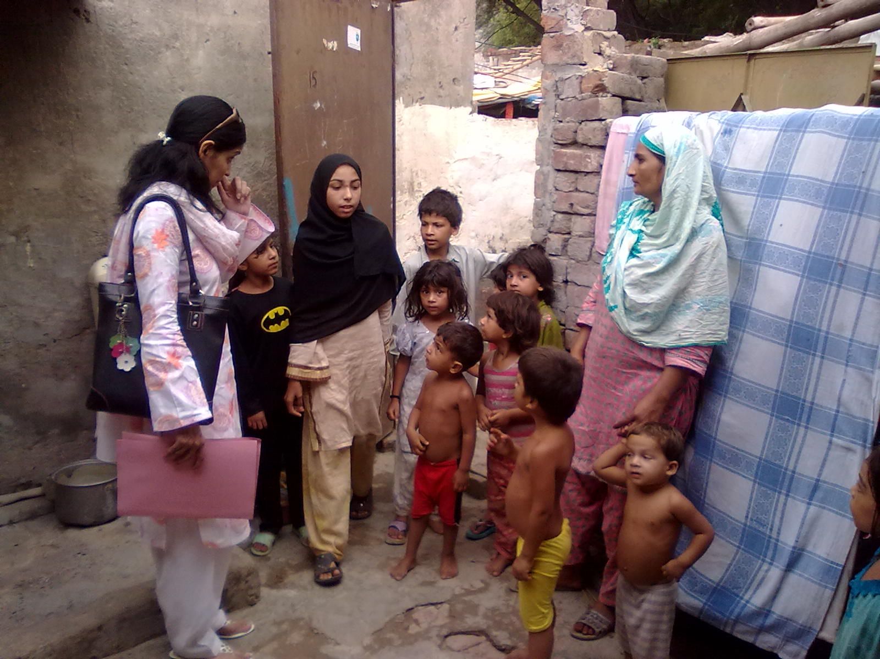
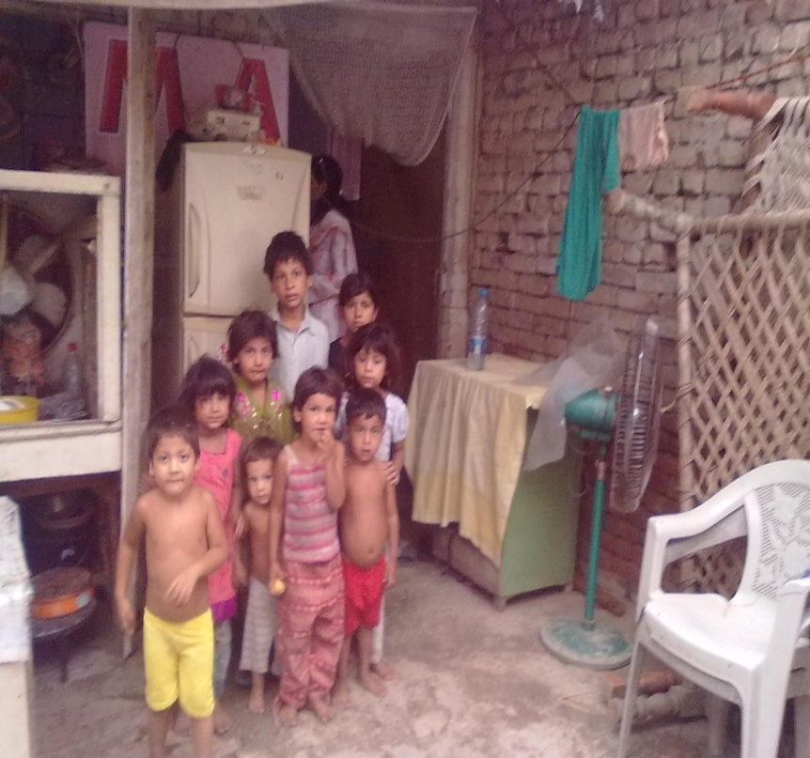
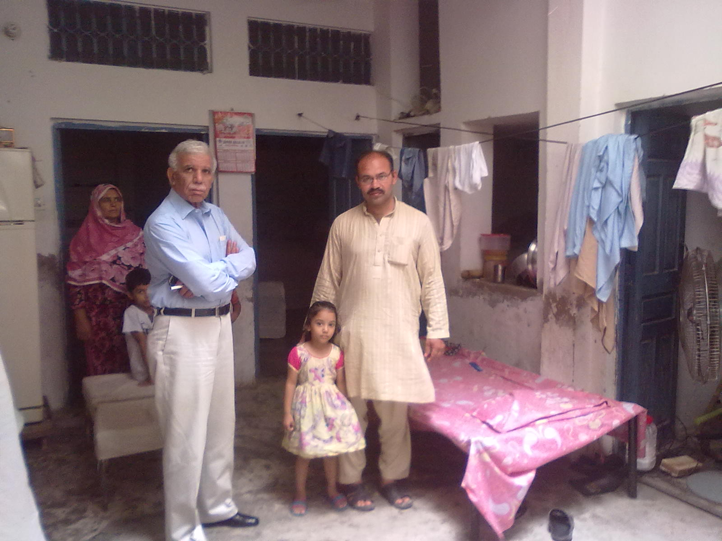
GROUND VERIFICATION

Slide 12
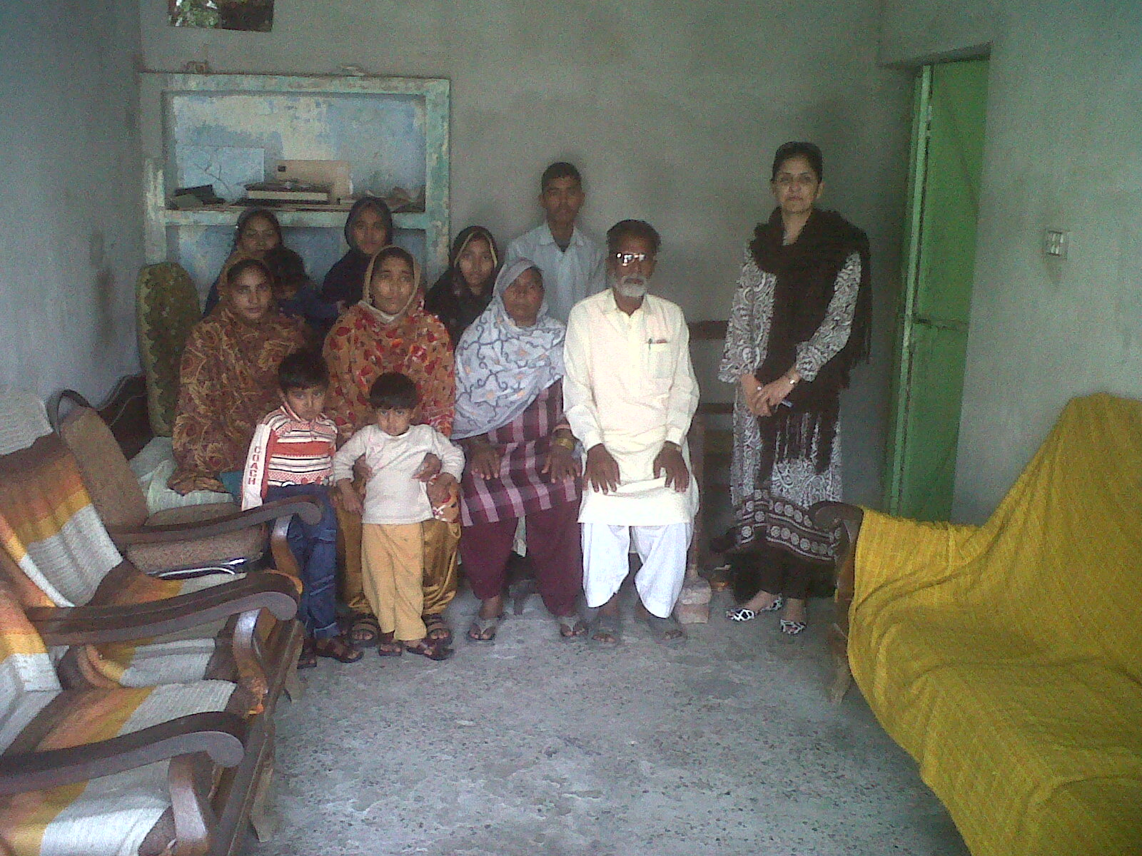
With Great Grand Parents-- 1st child likely to go beyond
Class 5 in over 120 years of known family history
G/ Mother
Ground Verifier
Mother
The Applicant
G/G Parents

Slide 13
What Do We Provide?
Contemporary Education 14 years of school education from Nursery to FSc Planned up to professional level ( 14 years in school, 4 years at universities and colleges or 2 years at military academies). Each cycle will take18 years. The first 4 ENTRIES ( Class of 1998-2016, 1999- 2017, 2000-2018 & 2001-2019) are already in universities starting 2nd half 2012 after 14 years of schooling at TAC. Another 6 months to 4 years to become competitive professional graduates. VALUE EDUCATION (TARBEEAT / GROOMING ) PASSES THROUGH ALL ACTIVITIES LIKE A SCARLET THREAD. Uniform and sports wear. Best available text books and scaled full range of stationery. Physical development and sports facilities. Periodic medical check up, first aid and preventive medical care.

Slide 14
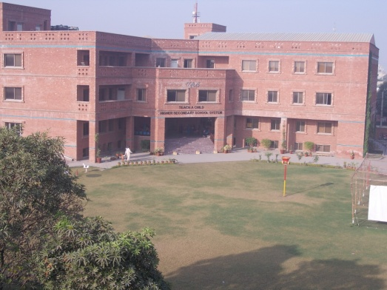
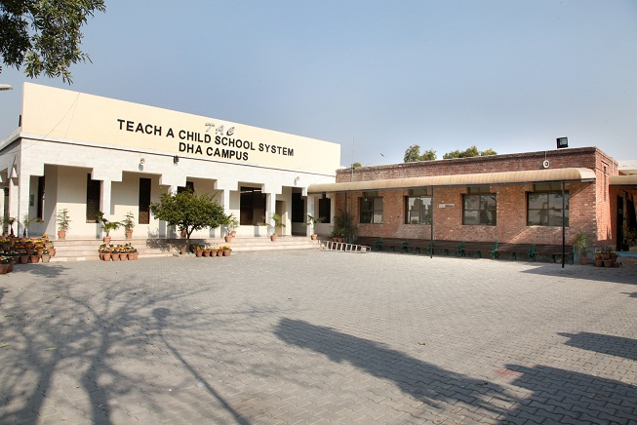
INSTITUTIONAL GROWTH

Slide 15
FIRST CAMPUS
22 Sep1998
Faisal Town, Lahore. 500 Square Yards. Single Storey Residential House
Rent: 15,000 PER MONTH

Slide 16
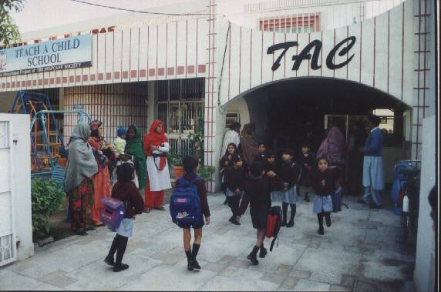
SECOND CAMPUS
1999 - 2003
500 Square Yards.
Double Storey Residential House
VERTICLE GROWTH
FAISAL TOWN
RENT: 30,000 PER MONTH

Slide 17
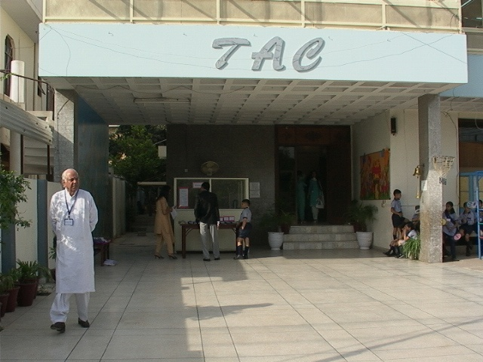
THIRD CAMPUS
2003-2008
1000 Square Yards.
Double Storey Residential House
VERTICLE GROWTH
MODEL TOWN
RENT:Rs: 50,000, VACATED AT Rs. 100,000

Slide 18
CUSTOM BUILT JOHAR TOWN CAMPUS
Total Area 1.5 Acres
Covered Area: 52,000 Sq. feet
OCCUPIED ON
14TH AUGUST 2008
VERTICLE GROWTH

Slide 19
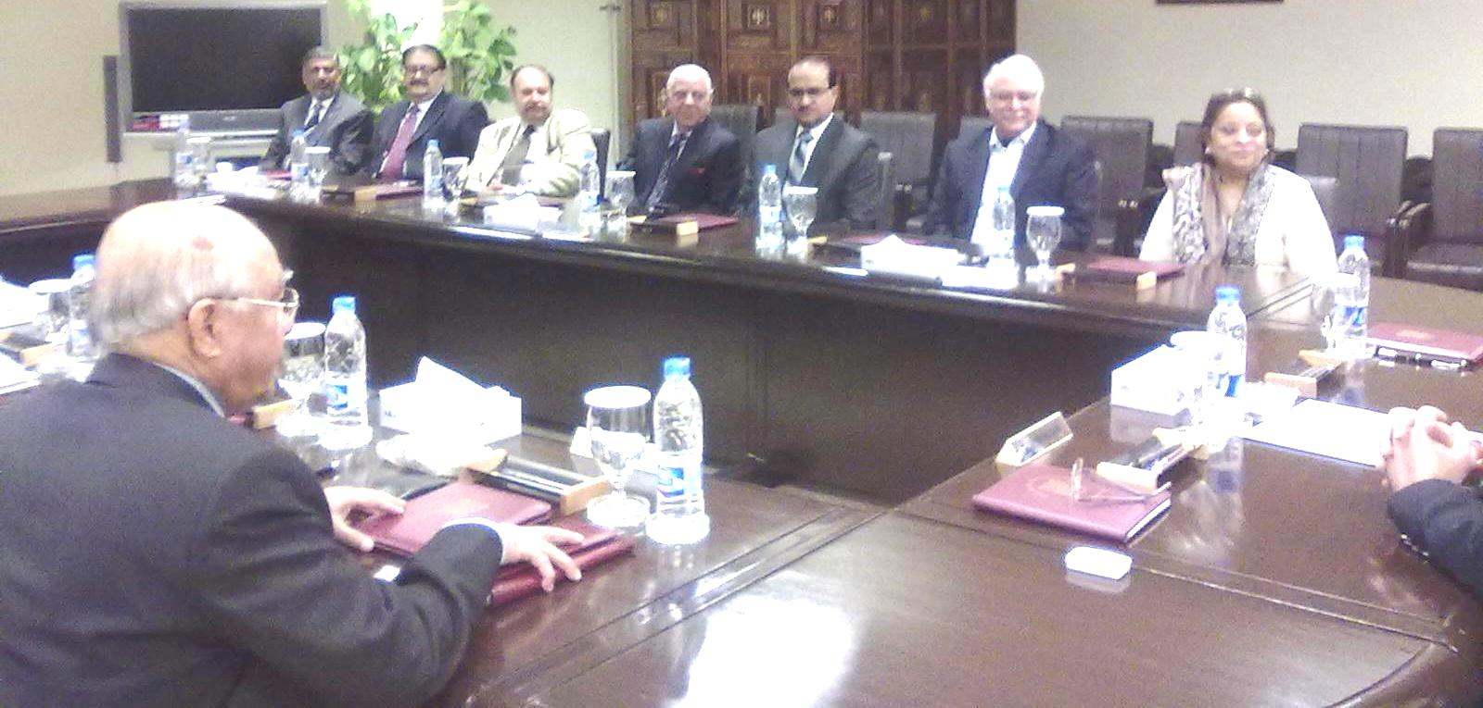
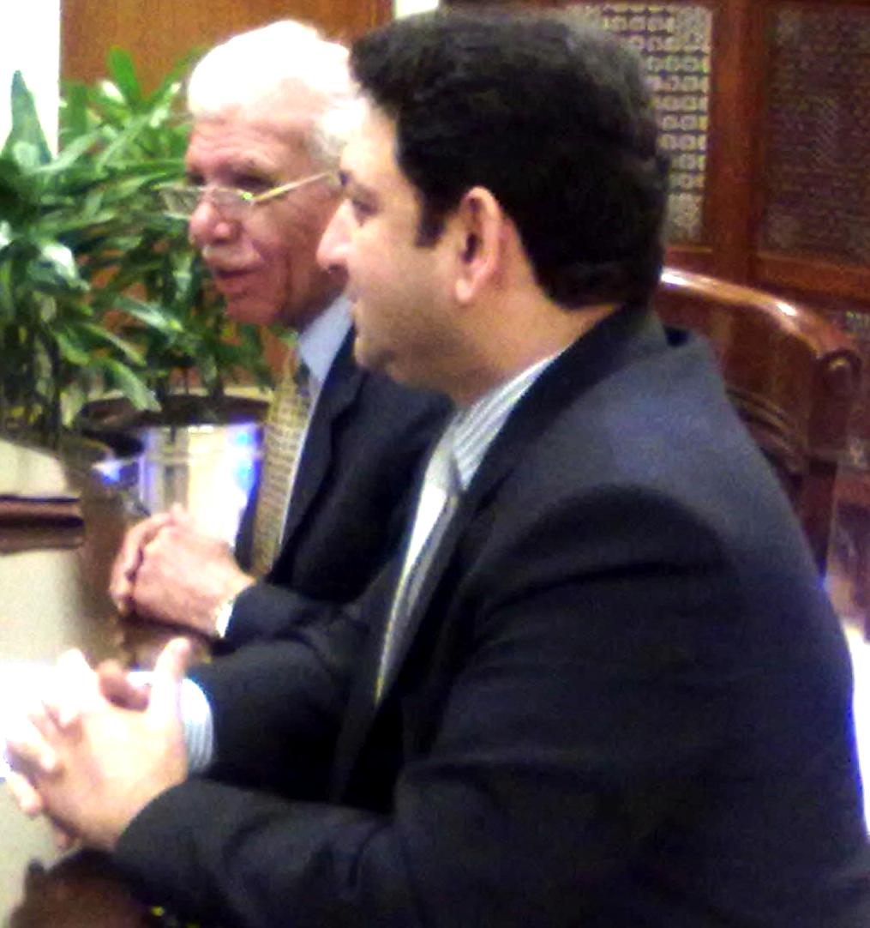
THE BEGINNING OF HORIZONTAL EXPANSION
AGREEMENT SIGNING CEREMONY
AT DHA CONFERENCE ROOM..

Slide 20
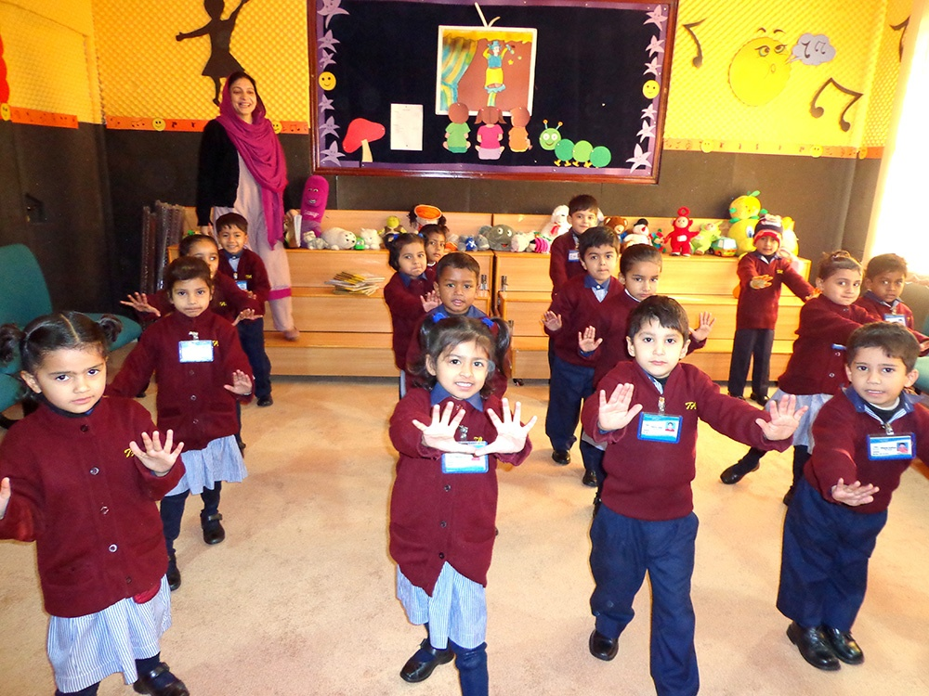
DHA
CAMPUS

Slide 21
HORIZONTAL EXPANSION OF THE CONCEPT FIRST CAMPUS, DHA LAHORE
6TH OCT 2012

Slide 22
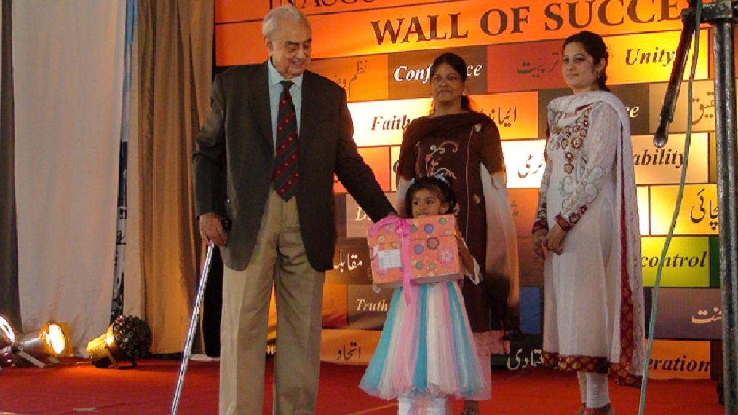
First Uniform Award
at DHA Campus
by Syed Babar Ali

Slide 23
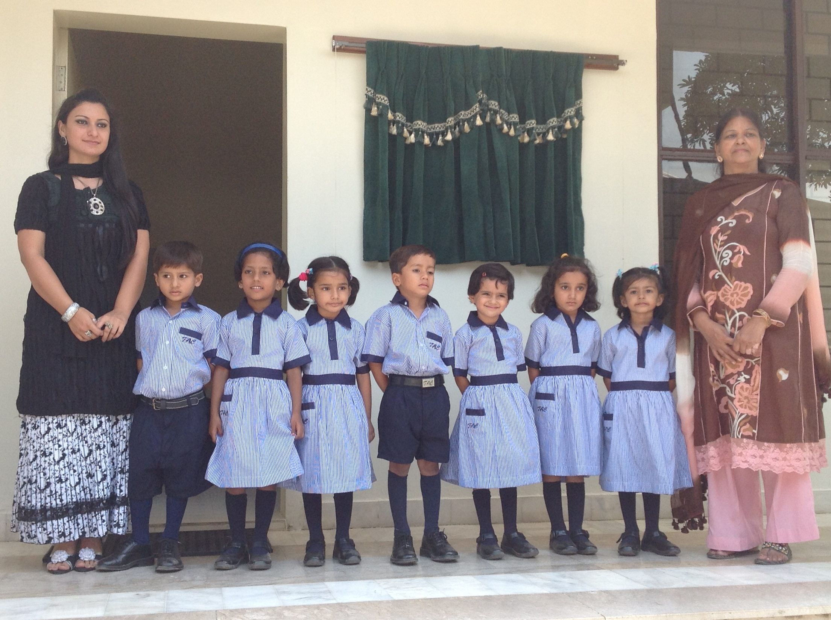
DHA CAMPUS INAUGURATION DAY

Slide 24
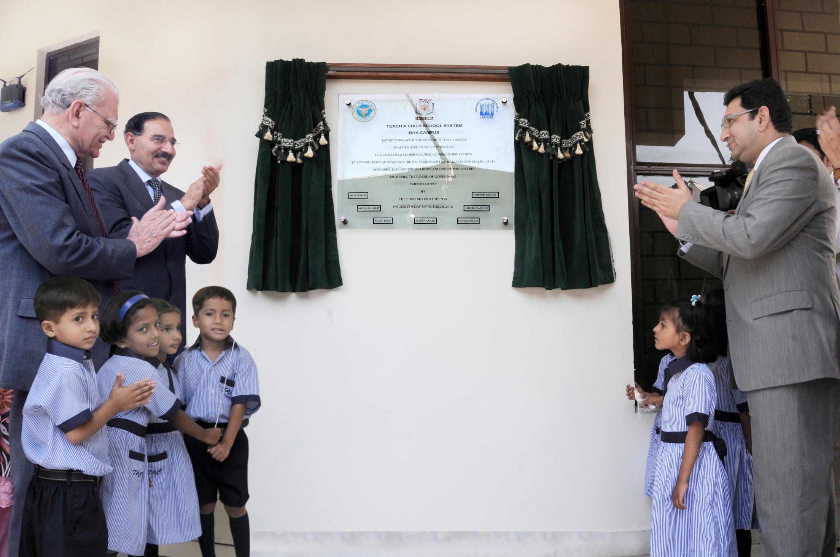
UNVEILING THE INAUGURAL PLAQUE BY THE STUDENTS FROM 1ST NURSERY AT DHA CAMPUS IN THE PRESENCE OF
GENERAL RASHAD MAHMOOD, CHAIRMAN, JCSC, BRIG HAROON MALIK, ADMINISTRATOR DHA LAHORE
& MR. M. YAHYA MIR, SENIOR MOST MEMBER OF BOG OF THE HELPCARE SOCIETY

Slide 26
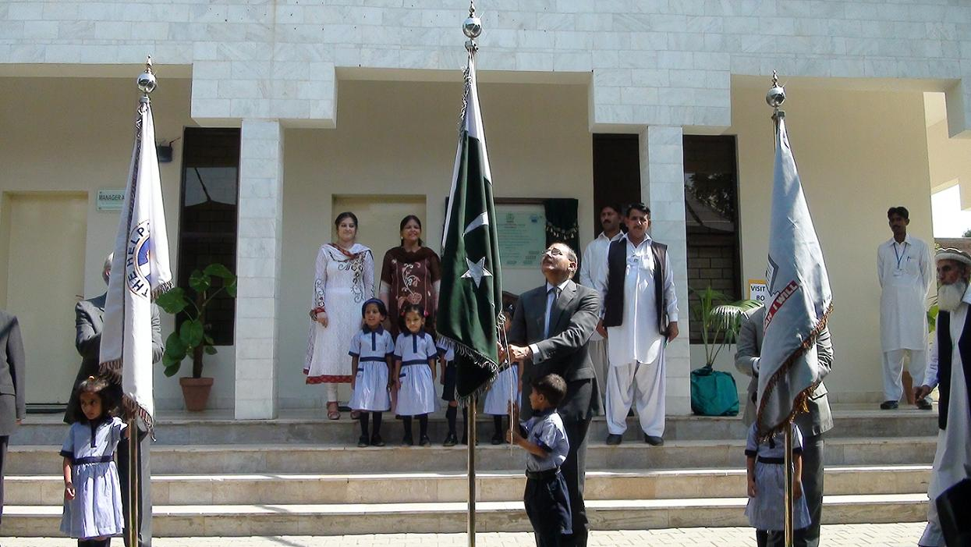
FLAG HOISTING CEREMONY

Slide 27
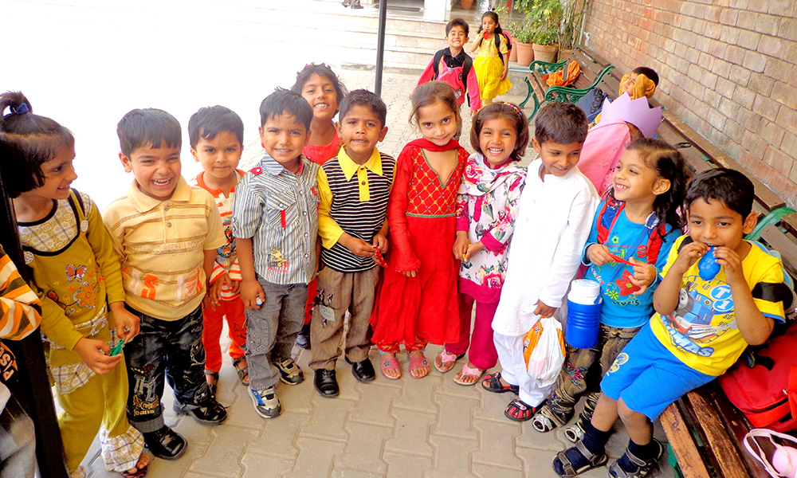
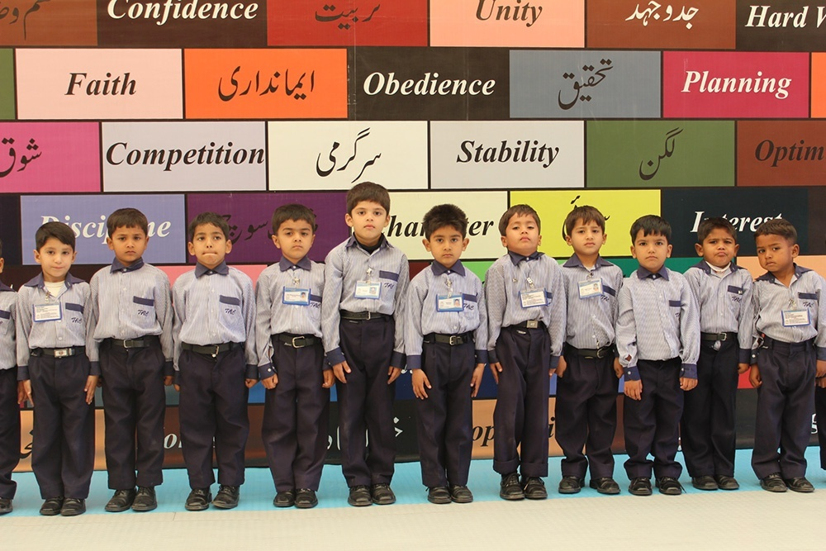
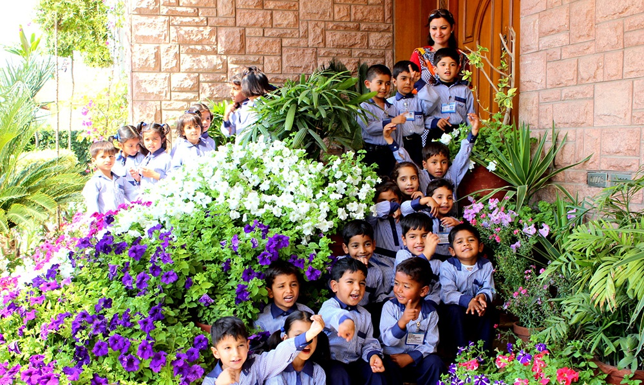
DHAC
GLIMPSES

Slide 28
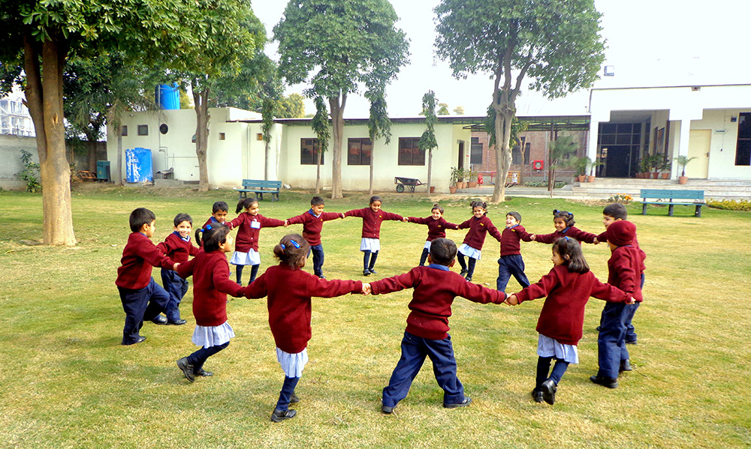
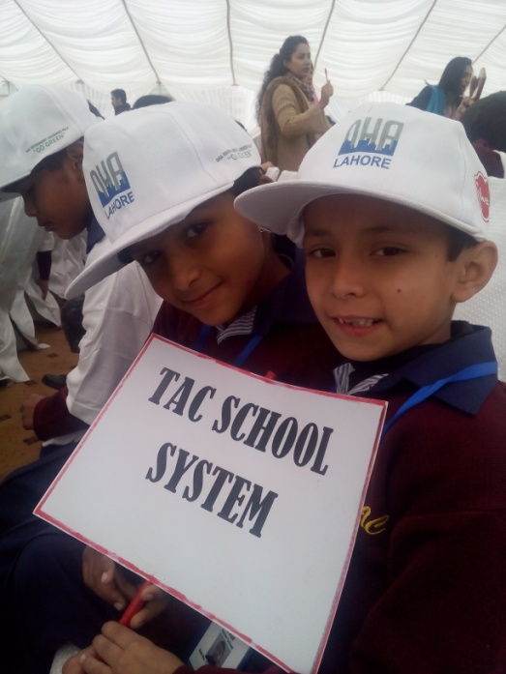
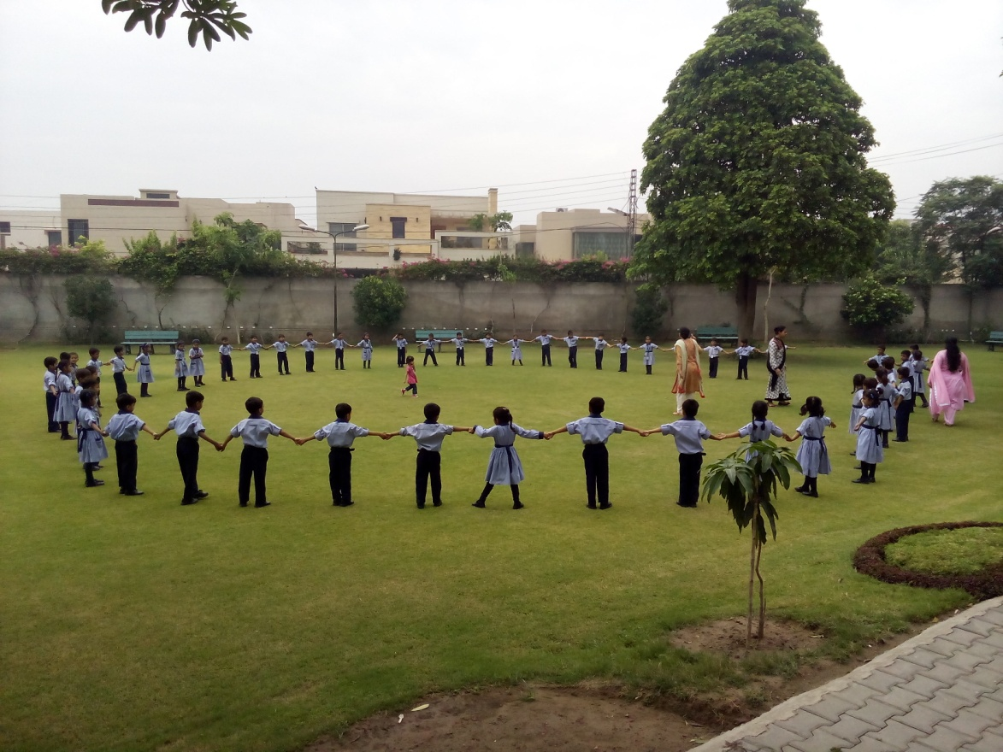
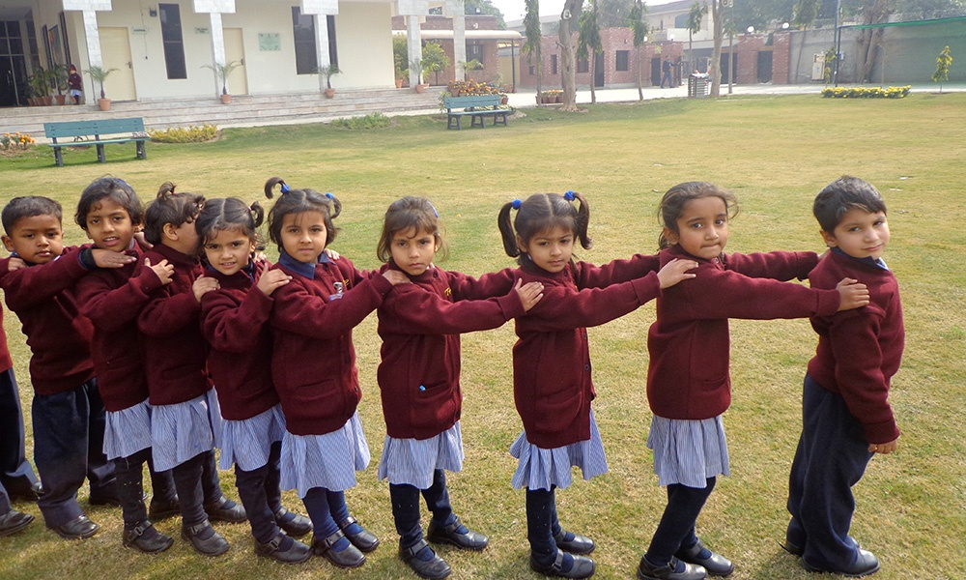
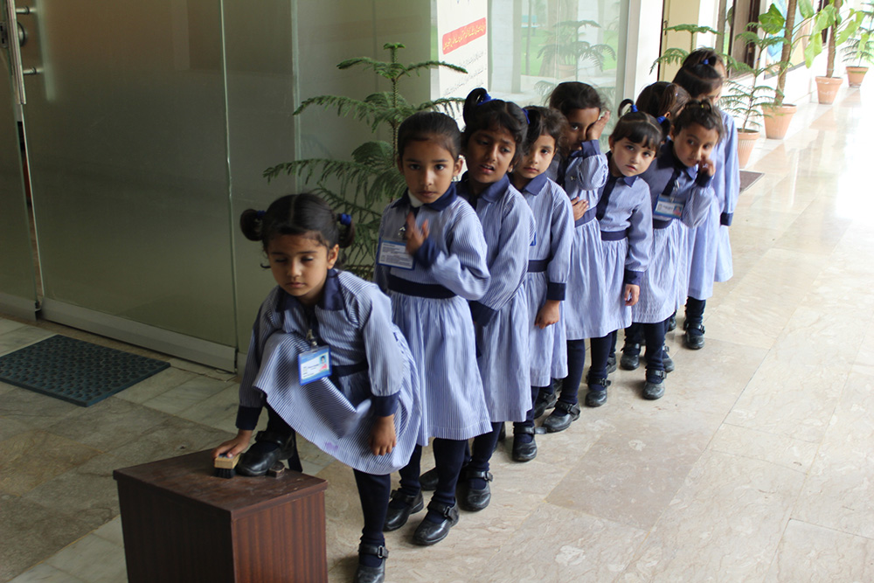
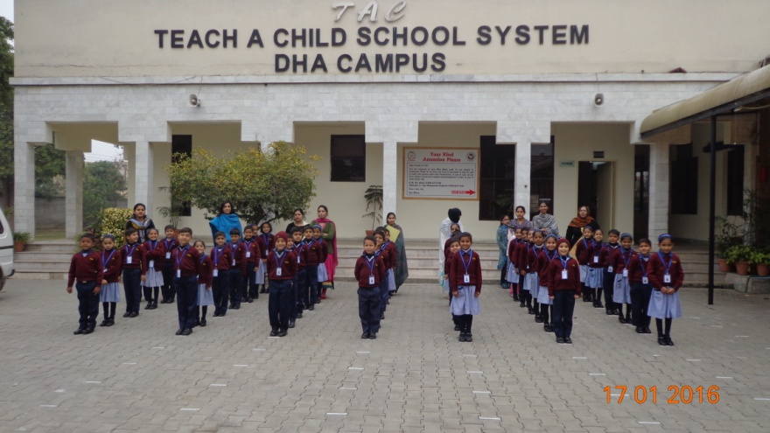

Slide 29
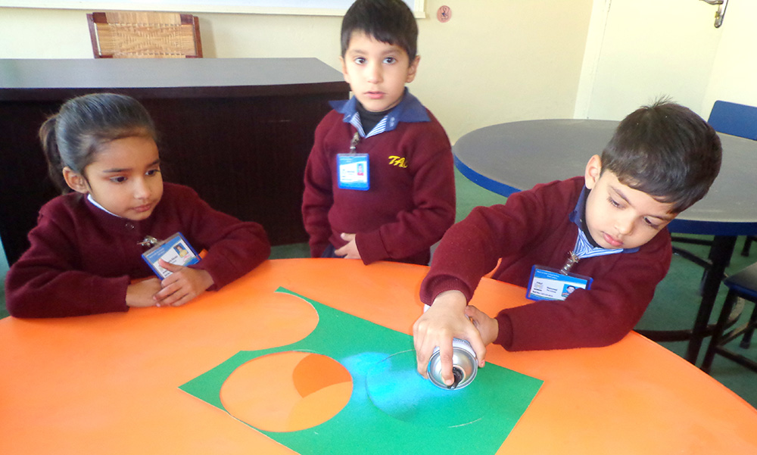
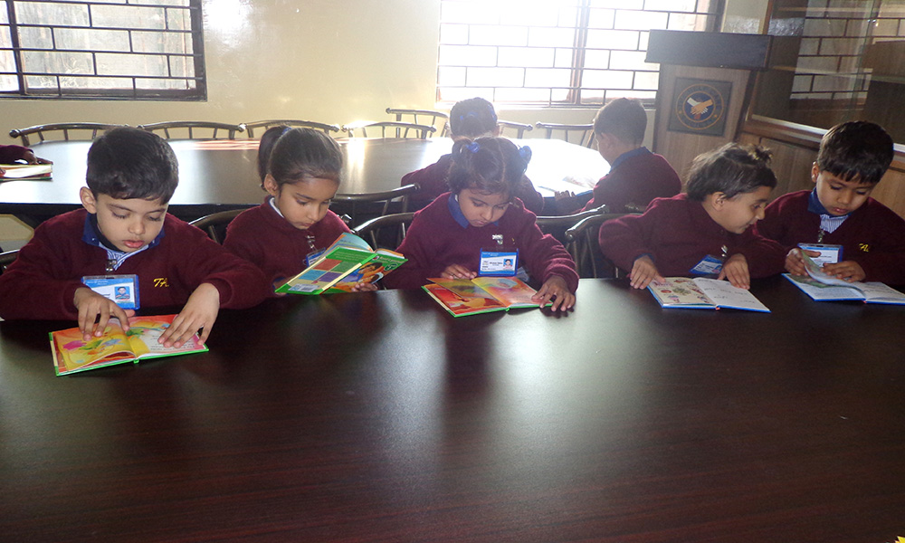
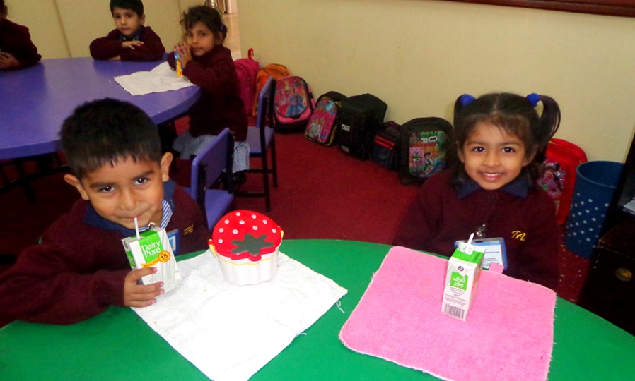
THE
TWINS

Slide 30
VOLUNTEER SUPPORT PROGRAMME
DHA CAMPUS INITIATIVE

Slide 31
STATISTICAL PROFILE

Slide 32
CURRENT POPULATION |
 | Johar Town | DHA | Total | Alumni in Universities
Total strength | 456 | 148 | 604 | 39
Classes | Nursery, Prep, Grade1 to 10 & TAC Intermediate College | Nursery, Prep & Grade 1
Number of Sections | 22 | 6
Total Classes | 14 | 3
Boys | 2 79(61%) | 95 (64%) | 374 (62%) | 12
Girls | 177(39%) | 53 (36.%) | 230 (38%) | 27

Slide 33
SUMMARY OF STUDENTS’ IQ PROFILE JOHAR TOWN AND DHA CAMPUSES
 | Rating | Total |  | % age
 |  | JT | DHA | JT | DHA
 | Very Superior | 125 | 35 | 27 | 24
 | Superior / Well Above Average | 147 | 35 | 32 | 24
 | Above Average | 135 | 51 | 29.5 | 34
 | Average | 48 | 27 | 10.5 | 18
Current Total |  | 456 | 148
Notes:
Summary of students’ IQ profile for the year 2015- Johar town and DHA campuses

Slide 34
PARENTS’ EDUCATION PROFILE
 | Education Level | Father |  | Mother
Campus |  | JT | DHA | JT | DHA
 | Illiterate | 5 6 | 36 | 8 6 | 54
 | Primary (Grade 5) | 55 | 35 | 75 | 35
 | Middle ( Grade 8) | 118 | 39 | 110 | 29
 | Matric (SC) (Grade 10) | 113 | 20 | 103 | 18
 | FSc / FA / I.COM | 65 | 7 | 57 | 5
 | BSc / BA / B Com | 34 | 2 | 22 | 7
 | MSc / MA / Dars e Nizami | 9 | 1 | 5 | 0
Total |  | 447 | 140 | 455 | 148
Notes:
This slide excludes orphans and parentless students of Johar Town and DHA campuses.

Slide 35
FATHERS’ OCCUPATION
Occupation | JOB DESCRIPTION ( Common to both campuses)
Private Service | Watchmen, hotel kitchen cleaner, cooks, rickshaw drivers, Wagon drivers, Filler at Petrol Station, Complaint Receiver (DHA), domestic Drivers, property agents, salesman, Tailors,hospital employees, teachers, stamp vendor, helper, storekeeper, Hakeem, embroider,Religious teacher
Government Service (Grade 1 to Grade 10) | Stenographers, policemen, telephone operators, account auditor, postman, clerks, school teachers, hospital ward Boys, nursing staff, Mujahids, Armed forces NCOs/ Soldiers, 1122 Rescue team, Sanitary Worker, gardeners
Self-employed | Donkey cart driver, rickshaw drivers, milkman, petty Shop keepers ,Laundryman, photographer, furniture Polisher, Goods supplier, electricians, plumbers etc
Daily wages / labourers | Denters, Painters, Carpenters, welders, electricians, Mechanics, labourers, Gardner
MOTHERS’ OCCUPATION
Office job, House maid, Seamstress, Domestic cook, Teacher, Nursing
Notes:
This slide excludes orphans and parentless students of Johar Town and DHA campuses.

Slide 36
OVERALL ECONOMIC PROFILE OF TAC FAMILIES
 | JT in PKR (USD) | DHA in PKR (USD)
 | 456 | 148
Average Family Strength | 5 | 5
Average Family Monthly Income | Pak Rupee 15,053 (148 USD ) pm | Rs. 14391 (142 USD) pm
Average Per Capita Income (per month/ per annum) | Pak Rs: 2379 (23 USD) pm / Rs. 28584 (281 USD) pa | Rs. 2159 pm (21 USD) / Rs.25,908 (255 USD) pa
Minimum Family Size | 3 | 3
Maximum Family Size | 13 | 13

Slide 37
OVERALL STUDENTS FEE & EXPENSE
Income
Monthly Dignity Fee per student | Rs. 5 (US Cents 5)
Monthly Income from 604 Students | Rs. 3020 (US $ 30 )
Yearly Income from 604 students | Rs. 36,360 (US $ 360)
Expenditure
Average per student cost per month | Rs. 3,000 (US $ 29 )
Average monthly expense | Rs. 1.66 million (US$ 16,600)
Average Yearly Expense | Rs. 20,000,000* (US$ 198,000 )

Slide 38
OVERALL BREAKDOWN OF MONTHLY EXPENSE PER STUDENT
 | Cost and %age
Average monthly share of staff salary | Rs. 2480 ( 82.7%)
Average monthly expense of books, stationery & other educational expenses | Rs. 300 ( 10%)
Average monthly utilities bills | Rs. 90 ( 3.%)
Average monthly share of repair & maintenance | Rs. 50 ( 1..5%)
Misc students’ related expense | Rs. 80 (3%)

Slide 39
MILE STONES
Milestone 1. Commencement of the project on 22 Sep 1998. It all
started, not so much with money but a belief in the intent to do it.
Money was limited and static in growth.
Milestone 2. Construction of a customized campus. Achieved after
10 years in 2008.
Milestone 3. First external examination. Mid 2009
Milestone 4. Completion of high school education. Mid 2010
Milestone 5. Intermediate education. Completion mid 2012. Participation in LUMS National Outreach program. Established linkages with other professional universities, Colleges, scholarship awarding organizations including corporate.
Milestone 6. Entry into professional education. 2nd half 2012.
Milestone 7. Conclusion of 1st 18 years cycle. Sep 2016. In Sha Allah.

Slide 40
BECOME A FRIEND OF TAC
An educational project of “THE HELPCARE SOCIETY”

Slide 41
SPONSORS & DONORS
Sponsorship Scheme. Adopting a student or a group of students through sponsorship scheme by contributing Pak Rs. 30,000 US $ 300 ) per sponsorship per year.
Cost of one class of 50 students ---1,500,000 ( US $ 14,300) per year
Note: @ One US $ = PKR 105
Participation in the Endowment Fund* * Profit is reinvested
Target: Rs.100 million ( US$ 1 million );
Current Status: Rs. 90 million (US$ 857,000);
Shortfall: Rs. 10 million ( US$ 95,238)
Updated on 22.3.2016 @ Rs. 105 to a dollar
Sponsoring a Facility of the Customized Campus.
Sponsor a standard classroom for Rs. 1,000,000 ( US $ 10,000 ). Separate cost estimate can be provided for other facilities, i.e. computer lab, library, art room, music room, sports infrastructure, Human Resource Development Centre , Teachers’ Development Centre etc.
** Per annum Increase in expense due to new induction of new students + inflation-14% - 16%
BECOME A “FRIEND OF THE TAC”

Slide 42
“ANYTHING FROM ENCOURAGEMENT
TO YOUR PARTICIPATION IS VALUABLE”

Slide 43
OUR
CORE VALUES
CREDIBILITY
TRANSPARENCY
PERFORMANCE
THANK YOU

